Slide 1
Chapter 16
Greedy Algorithms
Sun-Yuan Hsieh
謝孫源 教授
成功大學資訊工程學系

Slide 2
Introduction
Similar to dynamic programming.
Use for optimization problems.
Idea:
When we have a choice to make, make the one that looks best right now. Make a locally optimal choice in hope of getting a globally optimal solution

Slide 3

Activity selection
n activities require exclusive use of a common resource. For example, scheduling the use of a classroom.
Set of actives S={a₁ ,…, a_{n}}.
a_{i} needs resource during period [ s_{i} , f_{i} ) , which is a half-open interval, where s_{i} = start time and f_{i} = finish time.
Goal: Select the largest possible set of nonoverlapping (mutually compatible) activities

Slide 4
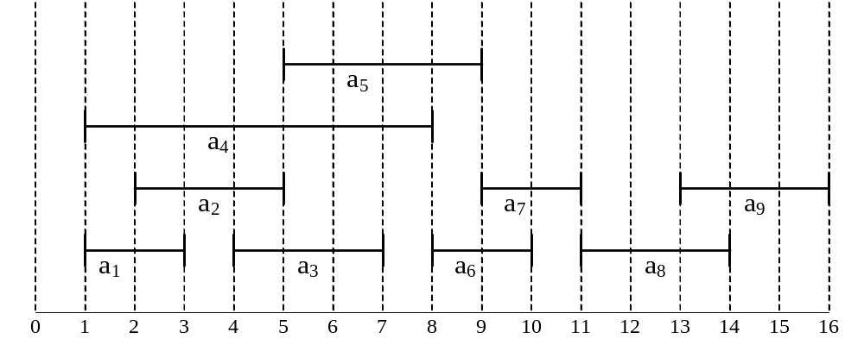
Example： S sorted by finish time:
Maximum-size mutually compatible set:[a₁,a₃,a₆,a₈].
Not unique: also[a₂,a₅,a₇,a₉].
i | 1 | 2 | 3 | 4 | 5 | 6 | 7 | 8 | 9
s_{i} | 1 | 2 | 4 | 1 | 5 | 8 | 9 | 11 | 13
f_{i} | 3 | 5 | 7 | 8 | 9 | 10 | 11 | 14 | 16

Slide 5
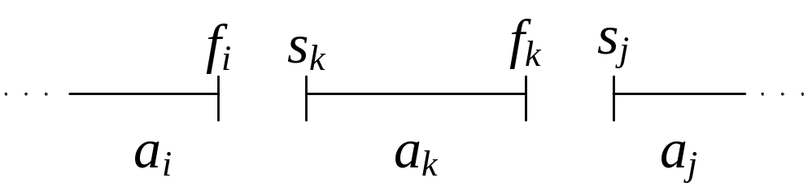
Optimal substructure of activity selection
S_{ij}= {a_{k} ∈ S：f_{i} ≤ s_{k} < f_{k} ≤ s_{j}}
= activities that start after a_{i} finishes and finish before
a_{j} starts.
Activities in S_{ij} are compatible with
  All activities that finish by f_{i} , and
  All activities that start no earlier than s_{j}.
To represent the entire problem, add fictitious activities:
  a₀=[-∞,0)
  a_{n+1}=[∞, “∞+1”)

Slide 6
We don’t care about -∞ in a₀ or “∞+1” in a_{n}+1.
Then S = S_{0,n+1}
Range for S_{ij} is 0 ≤ i, j ≤ n+1.
Assume that activities are sorted by monotonically increasing finish time：
f₀ ≤ f₁ ≤ f₂ ≤ … ≤ f_{n} < f_{n+1}
Then i ≥ j ⇒ S_{ij}=∅.
  If there exist a_{k} ∈ S_{ij} :
  f_{i} ≤ s_{k} < f_{k} ≤ s_{j} < f_{j} ⇒ f_{i} < f_{j}.
  But i ≥ j ⇒ f_{i} ≥ f_{j} , Contradiction.
So only need to worry about S_{ij} with 0 ≤ i < j ≤ n+1.
All other S_{ij} are ∅.
Suppose that a solution to S_{ij} includes a_{k}. Have 2 subproblems:
  S_{ik} (start after a_{i} finishes, finish before a_{k} starts)
  S_{kj} (start after a_{k} finishes, finish before a_{j} starts)

Slide 7
Let A_{ij} = optimal solution to S_{ij}.
So A_{ij} = A_{ik} ∪{a_{k}} ∪ A_{kj} , assuming:
  S_{ij} is nonempty, and
  We know a_{k}

Slide 8
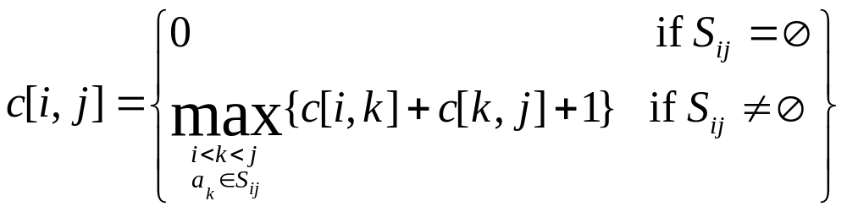

Recursive solution to activity selection
c[i,j] = size of maximum-size subset of mutually compatibles in S_{ij}.
i ≥ j ⇒
  If S_{ij} = Ø ⇒ c[i , j] =0.
i < j ⇒

Slide 9
Theorem
Let S_{ij}≠ Ø , and let a_{m} be the activity in S_{ij} with the earliest finish time :
f_{m} = min { f_{k} : a_{k} ∈ S_{ij} }. Then
1. a_{m} is used in some maximum-size subset of mutually compatible
avtivities of S_{ij}.
2. S_{im} = Ø , so that choosing a_{m} leaves S_{mj} as only nonempty subproblem.
Proof
1. Let A_{ij} be a maximum-size subset of mutually compatible activities in S_{ij},
Order activities in A_{ij} in monotonically increasing order of finish time.
Let a_{k} be the first activity in A_{ij}.
If a_{k}=a_{m}, done (a_{m} is used in a maximum-size subest).
Otherwise, construct A′_{ij}= A_{ij¯} {a_{k}} ∪ {a_{m}} (replace a_{k} by a_{m}).

Slide 10
Theorem
Let S_{ij}≠ Ø , and let a_{m} be the activity in S_{ij} with the earliest finish time :
f_{m} = min { f_{k} : a_{k} ∈ S_{ij} }. Then
1. a_{m} is used in some maximum-size subset of mutually compatible
avtivities of S_{ij}.
2. S_{im} = Ø , so that choosing a_{m} leaves S_{mj} as only nonempty subproblem.
Proof
2. Suppose there is some a_{k} ∈ S_{im}. Then f_{i} ≤ s_{k} < f_{k} ≤ s_{m}< f_{m} ⇒ f_{k} < f_{m}.
Then a_{k} ∈ S_{ij} and it has an earlier finish time than f_{m} , which
contradicts our choice of a_{m}.
Therefore, there is no a_{k} ∈ S_{im} ⇒ S_{im} = Ø .

Slide 11
Claim
Activities in A′_{ij} are disjoint.
Proof
Activities in A_{ij} are disjoint, a_{k} is the first activity in A_{ij} to finish, f_{m} ≤ f_{k}
(so a_{m} doesn’t overlap anything else in A’_{ij}). (claim)
Since | A′_{ij} | = | A_{ij} | and A_{ij} is a maximum-size subset, so is A′_{ij}. (theorem)
This is great :
before theorem after theorem
# of subproblems in optimal solution 2 1
# of choices to consider j – i – 1 1

Slide 12
How we can solve top down:
To solve a problem S_{ij}
  Choose a_{m} ∈ S_{ij} with earliest finish time: the greedy choice
  Then solve S_{mj}
What are the subproblems?
  Original problem is S_{0, n+1}
  Suppose our first choice is a_{m1}
  Then next subproblem is S_{m1, n+1}
  Suppose next choice is a_{m2}
  Nextsuproblem is S_{m2,n+1}
  And so on

Slide 13
Easy recursive algorithm:
Assumes activities already sorted by monotonically increasing finish time.
(If not, then sort in O(nlgn) time)
Return an optimal solution for S_{i,n+1}:
REC-ACTIVITY-SELECTOR( s , f , i, n )
m ← i+1
while m ≤ n and s_{m} < f_{i} ► Find first activity in S_{i,n+1}
do m ← m+1
if m ≤ n
then return {a_{m}}∪REC-ACTIVITY-SELECTOR( s , f , m , n )
else
return 0
Initial call: REC-ACTIVITY-SELECTOR( s , f , 0 , n )
Time: Θ(n) ― each activity examined exactly once.

Slide 14
Can make this iterative. It’s already almost tail recursive.
GREEDY-ACTIVITY-SELECTOR( s , f , n)
A←{a₁}
i←1
for m←2 to n
do if s_{m} ≥ f_{i}
then A← A ∪{a_{m}}
i←m ► a_{i} is most recent addition to A
return A
Time: Θ(n).

Slide 15
Greedy Strategy (typical streamline steps):
  Cast the optimization problem as one in which we make a choice and are left with one subproblem to solve.
  Prove that there’s always an optimal solution that make the greedy choice, so that the greedy choice is always safe.
  Show that greedy choice and optimal solution to subprblem ⇒ optimal solution to the problem.
No general way to tell if a greedy algorithm is optimal, but two key ingredients are
  greedy-choice property and
  optimal substructure.

Slide 16
Greedy-choice property
A globally optimal solution can be arrived at by making a locally optimal (greedy) choice.
Dynamic programming
  Make a choice at each step.
  Choice depends on knowing optimal solutions to subproblems.
  Solve subproblems first.
  Solve bottom-up.
Greedy
  Make a choice at each step.
  Make the choice before solving the subproblems
  Solve top-down.

Slide 17
Optimal substructure
Just show that optimal solution to subproblem and greedy choice ⇒ optimal solution to problem.
Greedy vs. dynamic programming
The knapsack problem is a good example of the difference.

Slide 18
0-1 knapsack problem
  n items.
  Item i is worth $v_{i}, weighs w_{i} pounds.
  Find a most valuable subset of items with total weight ≤ W.
  Have to either take an item or not take it ― can’t take part of it.
Fractional knapsack problem
  Like the 0-1 knapsack problem, but can take fraction of an item.
  Both have optimal substructure.
  But the fractional knapsack problem has the greedy-choice property, and 0-1 knapsack problem does not.
  To solve the fractional problem, rank items by value/weight: v_{i}/w_{i} .
Let v_{i} /w_{i} ≥ v_{i+1}/w_{i+1} for all i.

Slide 19
FRACTIONAL-KNAPSACK( v , w , W )
load ← 0
i ← 1
while load < W and i ≤ n
do if w_{i} ≤ W-load
then take all of item i
else take (W-load)/w_{i} of item i
add what was taken to load
i ← i+1
Time: O( nlgn ) to sort, O(n) thereafter.

Slide 20
Greedy don’t work for 0-1 knapsack problem
W = 50
Greedy solution :
  Take items 1 and 2.
  value = 160, weight = 30.
Have 20 pounds of capacity left over.
Optimal solution :
  Take items 2 and 3.
  value = 220, weight = 50.
  No leftover capacity.
i | 1 | 2 | 3
v_{i} | 60 | 100 | 120
w_{i} | 10 | 20 | 30
v_{i} / w_{i} | 6 | 5 | 4

